Slide 1
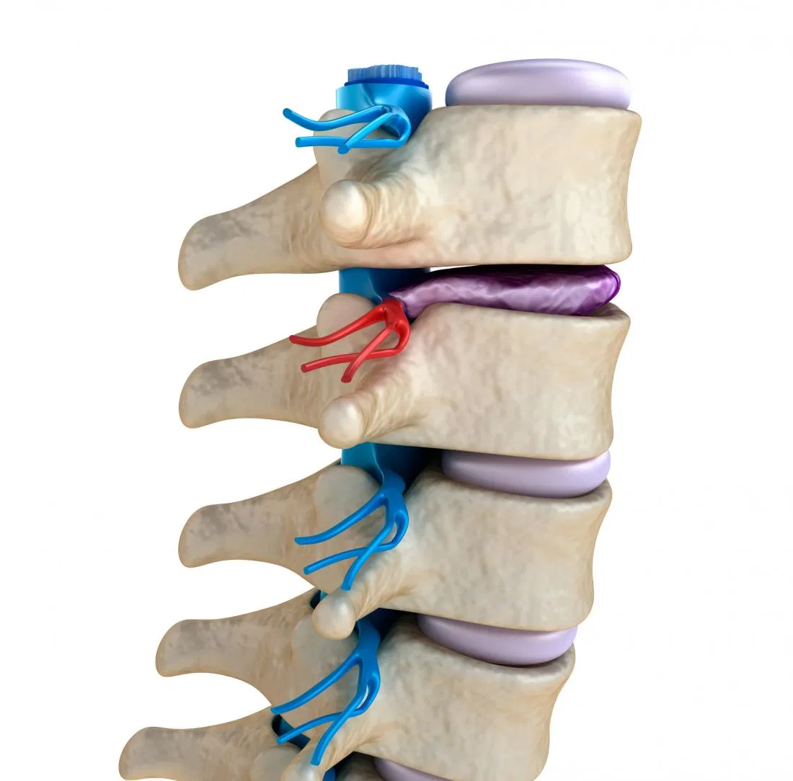
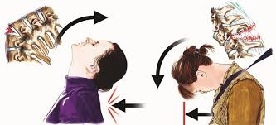
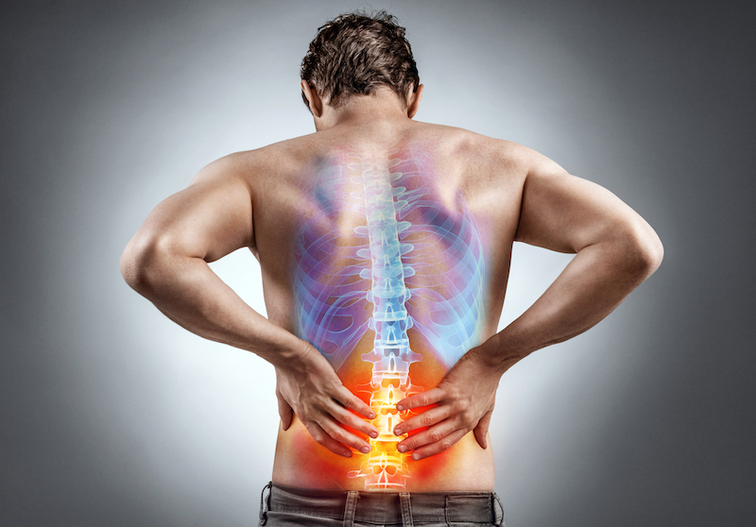
DEGENERATIVE DISC DISEASE (DDD)
Health and Lifestyle
Class - 13

Slide 2
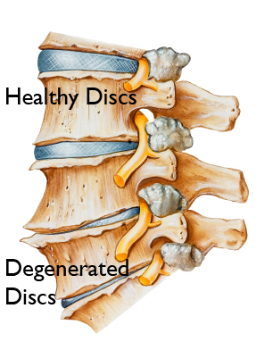
DEGENERATIVE DISC DISEASE (DDD)
Degenerative disc disease is a "disease of aging", an age related disease causesing low back pain and neck pain. Over the years and decades, the repeated daily stresses on the spine and occasional minor, unnoticed injuries, as well as major ones, begin to take their toll.

Slide 3
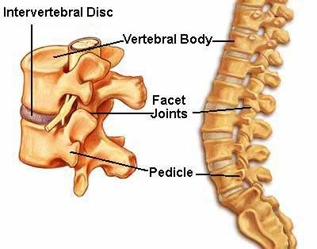
WHAT ARE THE INTER VERTEBRAL DISCS?
The intervertebral discs form the vertebrae's shock absorbers. They act as padding, and cushion the stress when the spine moves or bears weight. These spinal discs also help the spine bend and then bend back to its normal curves.
In a healthy young adult the intervertebral discs consist of about 90% water. As we age the water content goes down, the padding becomes less thick and the spine becomes slightly shorter as a result. Sometimes the disc might bulge.

Slide 4
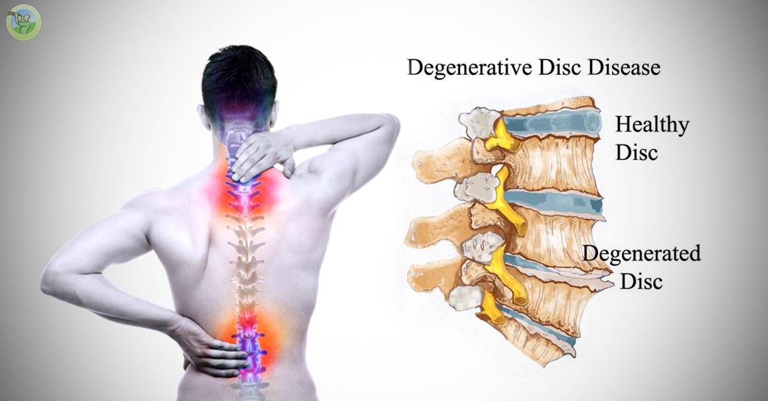
DEFINITION
This is a condition of the discs between vertebrae with loss of cushioning, fragmentation and herniation related to ageing.
There may be no symptoms. In some cases, the spine loses flexibility and bone spurs may pinch a nerve root, causing pain or weakness.

Slide 5
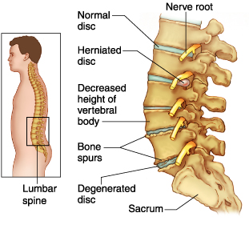
Consequencesof DDD

Slide 6
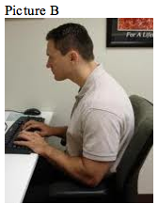
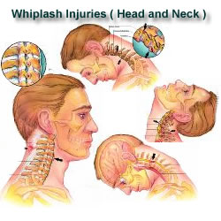
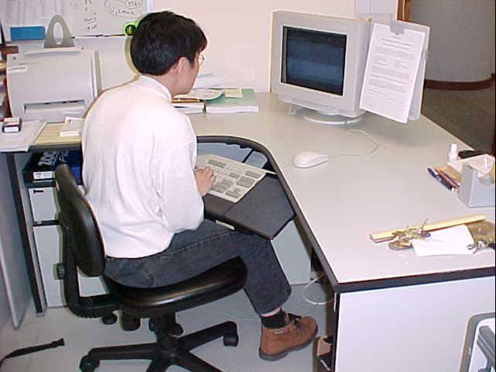
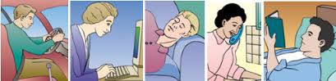
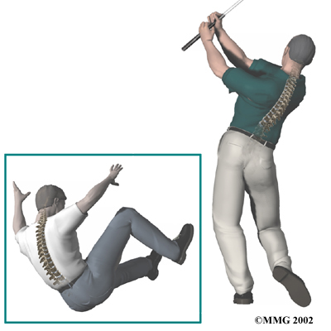
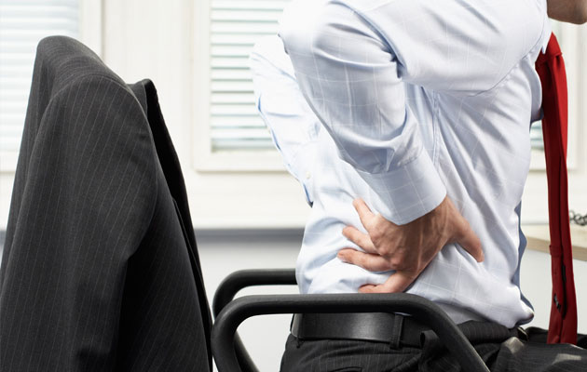

Slide 7
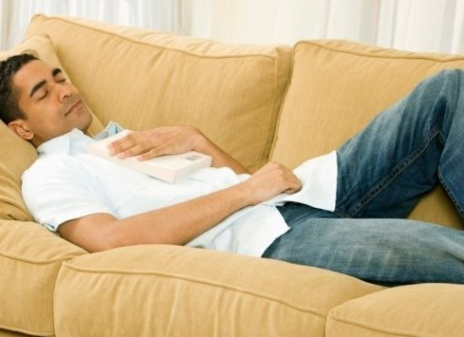
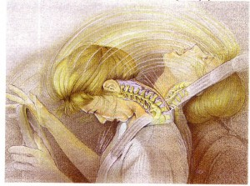
WHAT ARE THE CAUSE’S DEGENERATIVE DISC DISEASES?
As the human body ages, the intervertebral discs degenerate (break down), which leads to degenerative disc disease in some individuals.
Work postures
Sleeping postures
Aging-wear and tear
Loss of fluid
Disc structure is affected
Obese individuals- increased in weight
Tobacco smokers
Regular strenuous physical workers
An acute sudden injury or fall

Slide 8
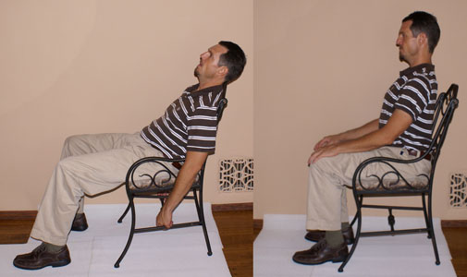
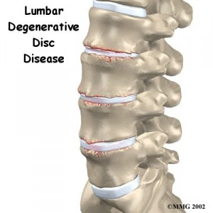
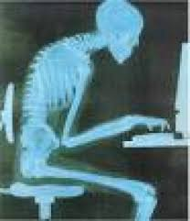
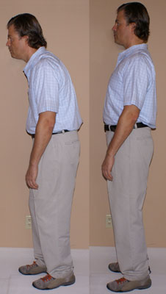
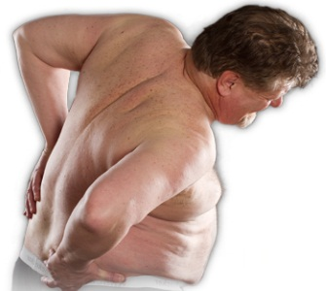

Slide 9
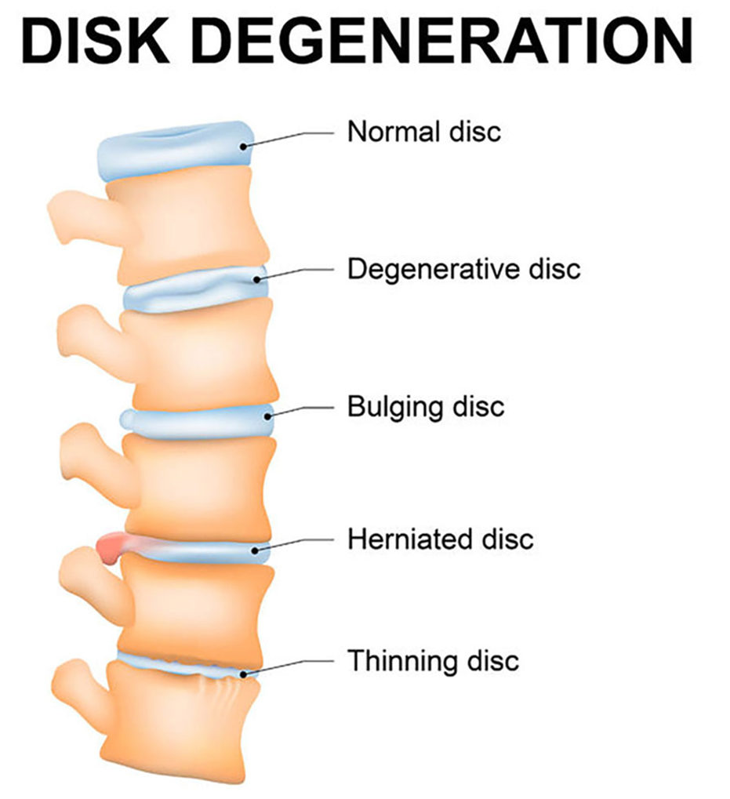
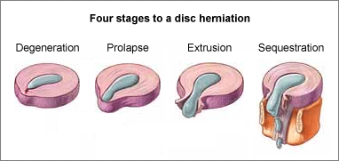
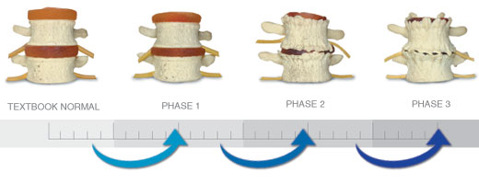

Slide 10
When the vertebrae have less padding between them the whole spine becomes less stable.
The body tries to cope with this by building osteophytes, also called bone spurs.
Bone spurs are small bony projections that develop along the edge of bones.
These projections can press against the spinal cord or spinal nerve roots, which undermine nerve function and cause pain.
There is a condition called spinal stenosis, which occurs when the bone spurs grow into the spinal canal and press into the spinal cord and nerves.
These conditions results due to lifestyle, postures while at work, sleep, etc, wear and tear, age related also.

Slide 11
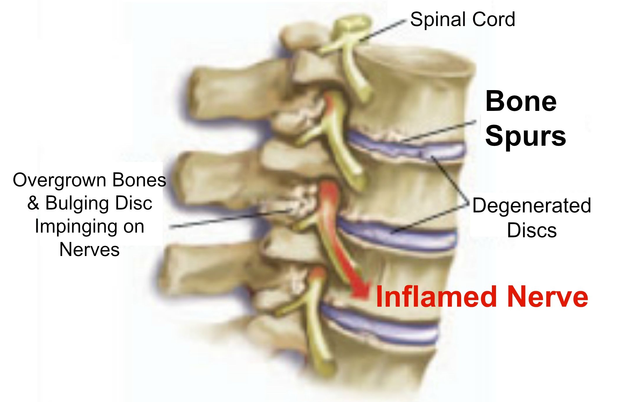
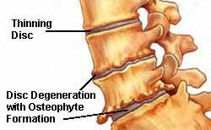
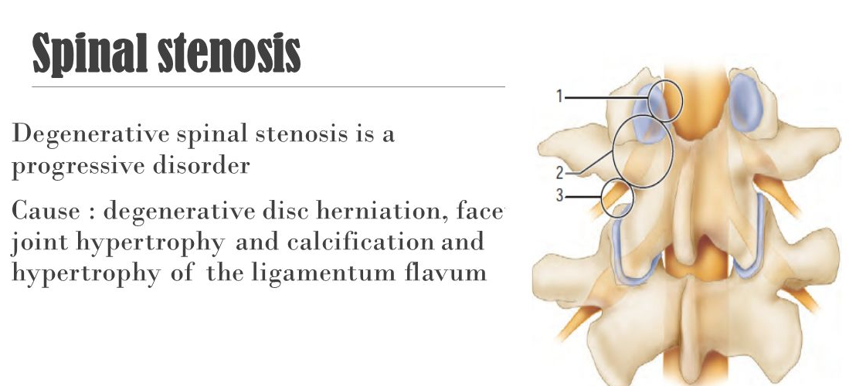

Slide 12
TREATMENT
Treatment may include occupational therapy, physical therapy, or both, special exercises, medications, losing weight, and surgery. Medical options include injecting the joints next to the damaged disc with steroids and a local anesthetic. These are called facet joint injections. They can provide effective pain relief.

